Slide 1
Hello everyone, Welcome to MasterSoft student Login.
Let’s understand how you can Successfully Complete Online Registration Process.

Slide 2
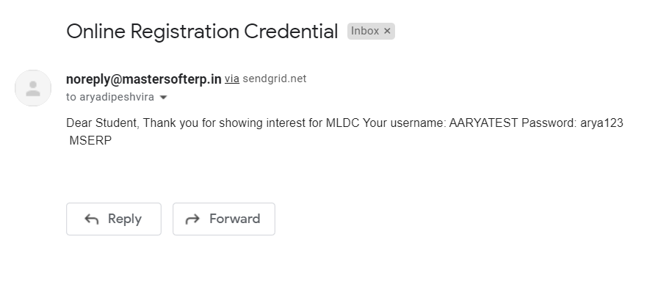
TEXT MESSAGE CONFIRMATION
Step3: Login Credentials will be received on your registered Mobile Number or Email-id Respectively.
Mobile Number or Email-id Respectively.
Student
MOBILE NUMBER
Student@123
Student and Password is: Student@123
EMAIL ID

Slide 3
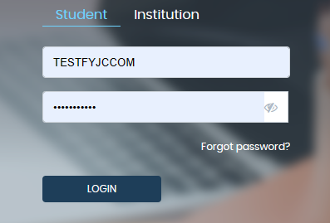
STUDENT LOGIN
Step1: URL : https://enrollonline.co.in/Registration/Apply/PDLCJR Click on “Go To Login” button present on the bottom of screen. Now enter the credentials which you have received on sms or email and click on the login option to Successfully Login To The System.
Student

Slide 4
TERMS AND CONDITION PAGE
Step2: This is Terms and Condition Page. Here student have to simply click on “Accept” button to proceed further.

Slide 5
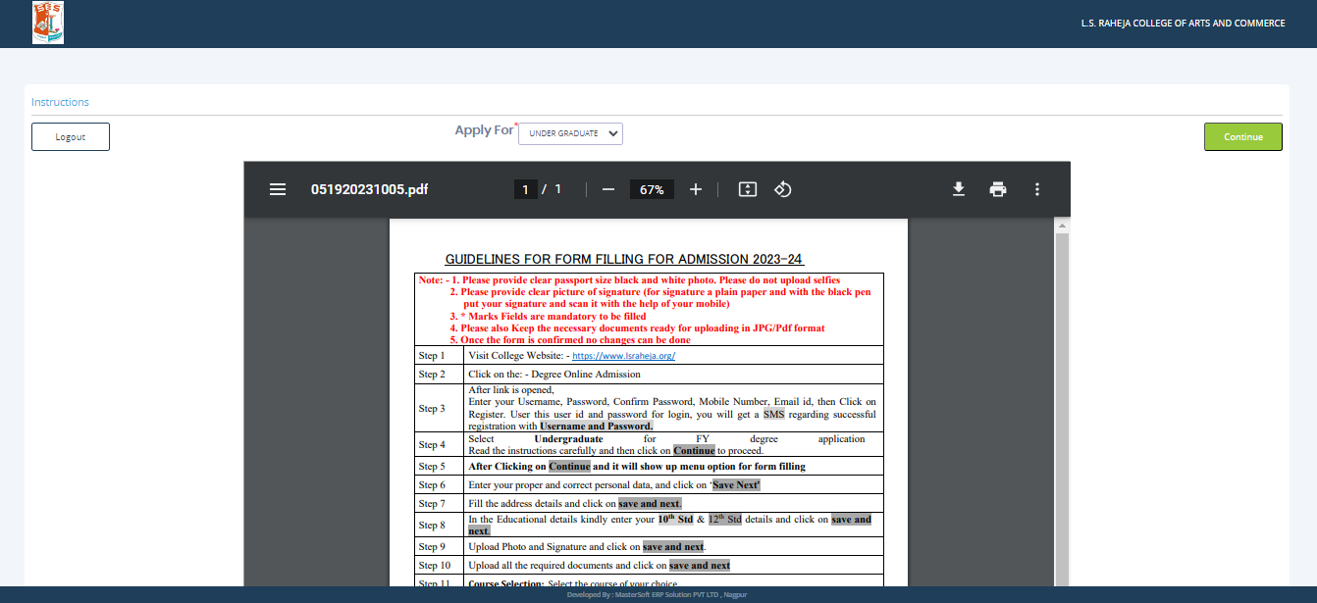
COURSE LEVEL SELECTION
Step 3: Select Course level JUNIOR COLLEGE using drop down
To proceed further click on “Continue” button.

Slide 6
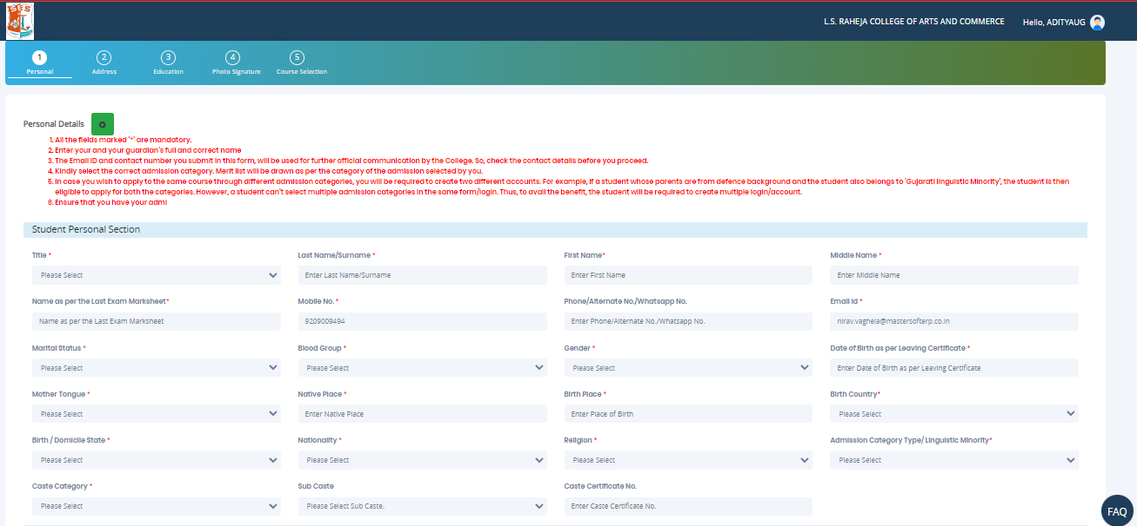
PERSONAL DETAILS
Step4: This is Personal Details Page, here student need to enter their Personal Details Such as first name, middle name, last name, email, gender etc. (Please note that all the red mark fields are mandatory).

Slide 7
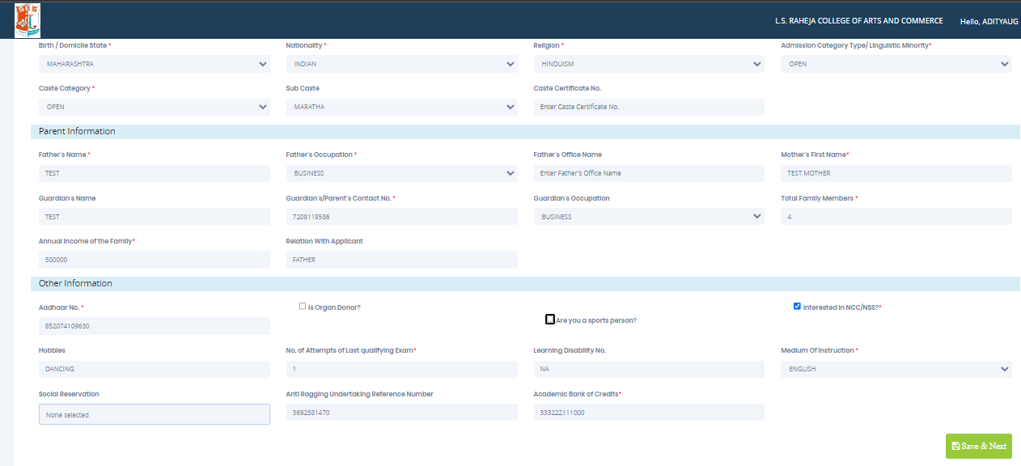
PERSONAL DETAILS
Step5: Once the student complete filling the personal details then they need to click on “Save and Next Button". (Please note that all the red mark fields are mandatory).

Slide 8
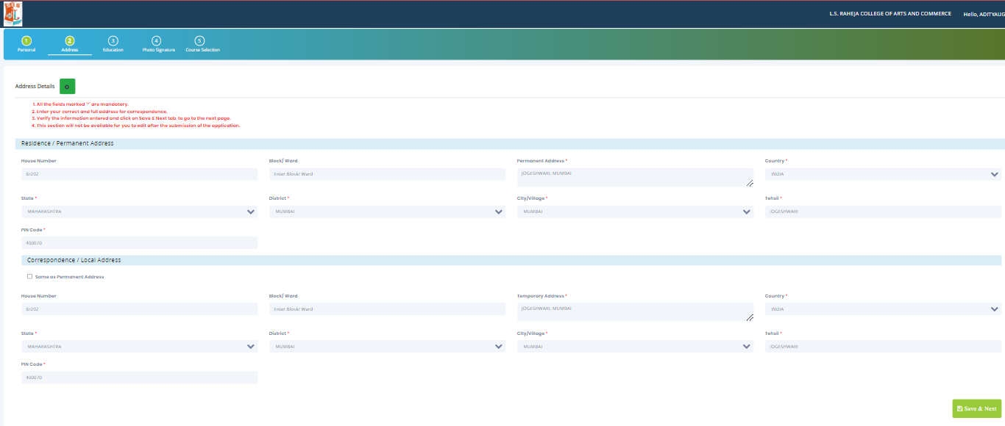
ADDRESS DETAILS
Step6: Next page is Address Details Page, here student need to fill their Personal or Local address. Once the student complete filling the personal details then they need to click on “Save and Next Button". If both Address are Same then click on “Same as Permanent Address” option present on screen. Once student complete filling the address details form then click on “Save and Next Button".

Slide 9
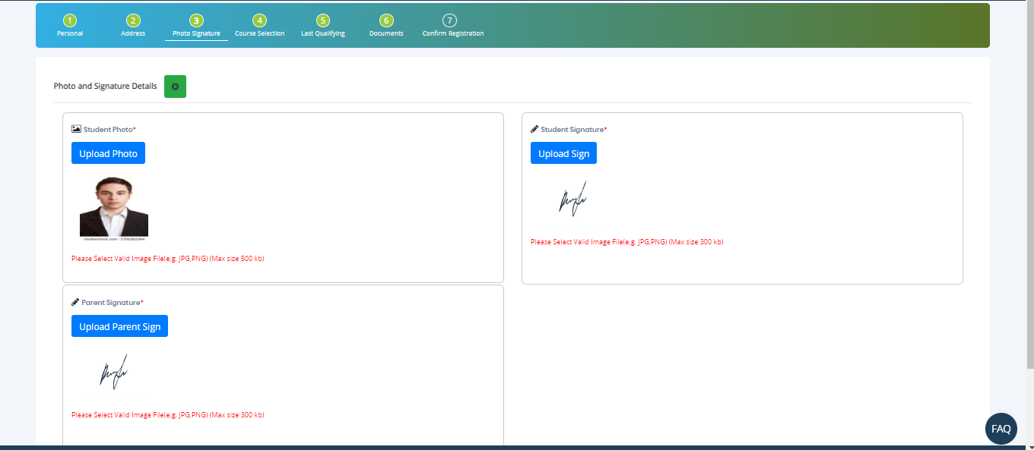
Photo and sign
Step7: Next page is Photo and sign, here student need to upload Photo and sign and parent sign . Once the student complete uploading the photo and sign details then they need to click on “Save and NextButton".

Slide 10
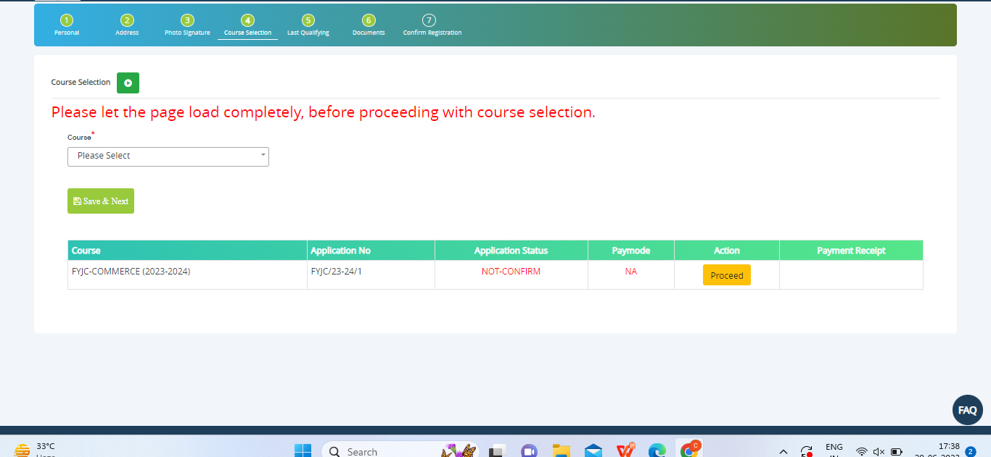
Course selection
Step8: Next page is Course selection , here student need to select the course . Once the student select the cousre then they need to click on “Proceed".

Slide 11
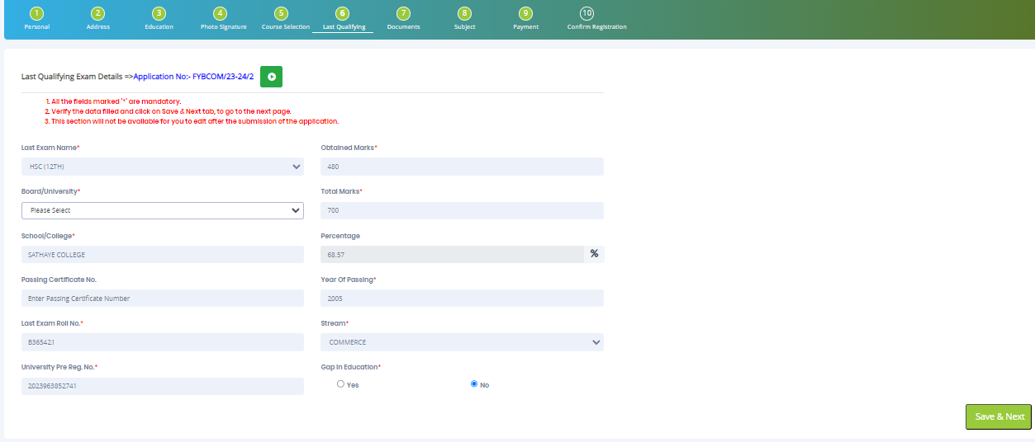
LAST QUALIFYING DETAILS
Step 9: Next page is Last Qualifying Details Enter your Last qualified exam details (For Eg. SSC 10th)
Click on “Save and Next” Button to proceed further.

Slide 12
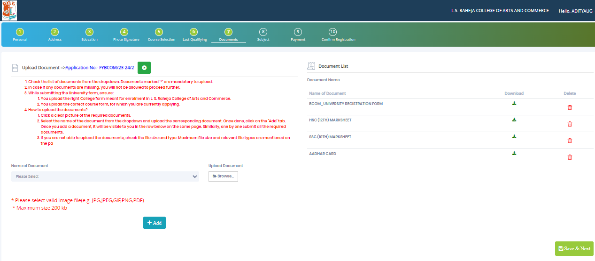
DOCUMENT DETAILS
Step10: Next page is Document Details Page, here student need to submit all the Required Documents which are Mandatory. Click on the Upload Documents button and select the Desired Document which students want to upload. Once students complete submitting all the documents then they need to click on “Submit Button". (Note: Document max size should 200kb)

Slide 13
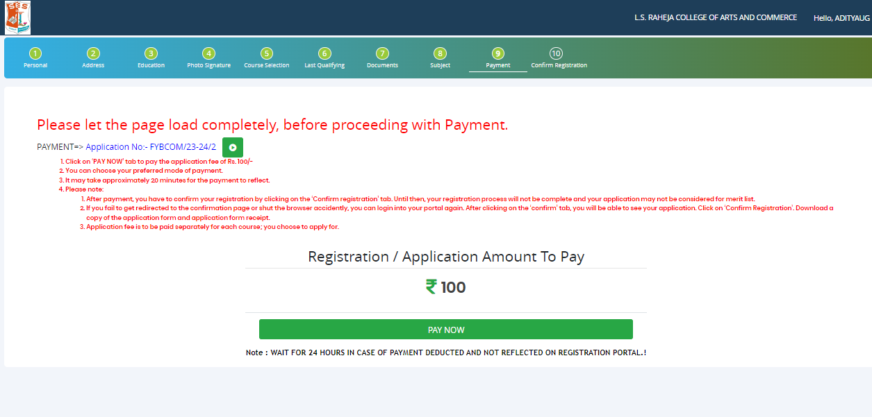
PAYMENT
Step 11: Please click on “PAY NOW” button to complete the Payment process

Slide 14
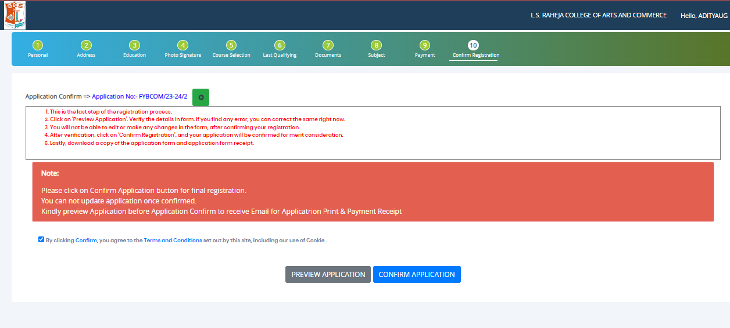
PREVIEW/CONFIRM APPLICATION
STEP 12: Click on ‘PREVIEW APPLICATION’ button to check all the details entered by you in the form are correct. If any Correction is there then please do the necessary changes and Click on ‘CONFIRM APPLICATION’

Slide 15
THANK YOU

